Slide 1
Member Benefits What Joining Means for You

Slide 2
What is PRSSA?
The Public Relations Student Society of America (PRSSA) is a pre-professional organization for college students interested in public relations and communications.
PRSSA:
Seeks to advance the public relations profession.
Advocates for rigorous academic standards for public relations education, ethical principles and diversity.
Serves 7,000+ students at 300+ Chapters in the United States, Argentina, Colombia, Puerto Rico and Peru.

Slide 3
If you want experience and a job …
PRSSA helps you gain critical experience for finding jobs and excelling in the workforce.
PRSSA keeps you informed with the latest industry news, trends and job postings.
The PRSSA and PRSA network provides lasting and meaningful connections.

Slide 4
Why become a PRSSA member?
Enhance your education
Broaden your network
Launch your career
Gain real-world experience

Slide 5
Leadership
Potential employers find value in applicants with PRSSA leadership experience. PRSSA leaders can:
Work with a variety of members and fellow leaders.
Serve at the Chapter level.
President, vice president, secretary, treasurer, public relations director and other positions available.
Lead a Student-run Firm or take an active role on an account.

Slide 6
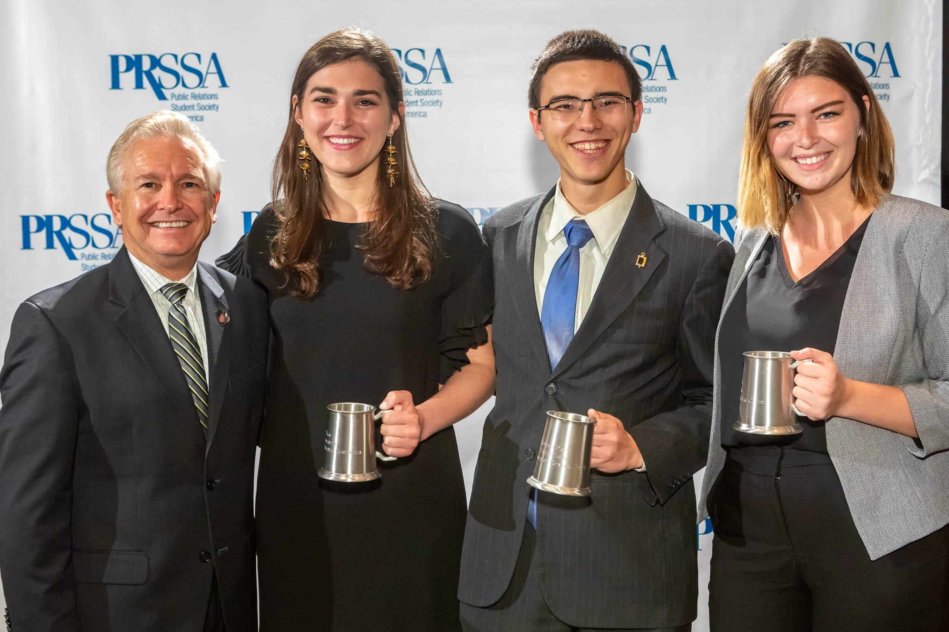
Events
Network, learn and interact with students from around the country.
Travel the country for events:
International Conference
Leadership Assembly
District Conferences

Slide 7
Upcoming Events
International Conference:
Professional development, networking and awards dinner
https://www.prsa.org/conferences-and-awards/icon-2021
Leadership Assembly:
National Committee elections, bylaw revisions and leadership development.
https://www.prsa.org/prssa/events/leadership-assembly

Slide 8
Competitions & Campaigns
Examples:
Bateman Case Study Competition
National Organ Donor Awareness Competition
By participating, you can:
add to your portfolio
gain real-world experience
work with high-profile clients
win prizes and awards

Slide 9
Scholarships & Awards
Earn recognition for your accomplishments
Chapter and individual awards available
Fund your education
More than $30,000 available for students through scholarships and awards
Opportunities for every student:
Graduate and undergraduate students
Leaders, interns and mentors
Diverse students

Slide 10
News & Intelligence
Stay current with industry news by receiving:
PRSA Issues & Trends
PRSA Strategies & Tactics
News updates from PRSSA
Follow PRSSA Social Media Channels

Slide 11
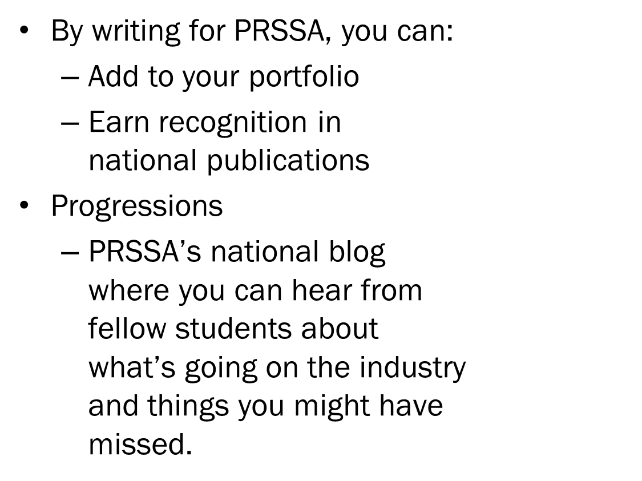
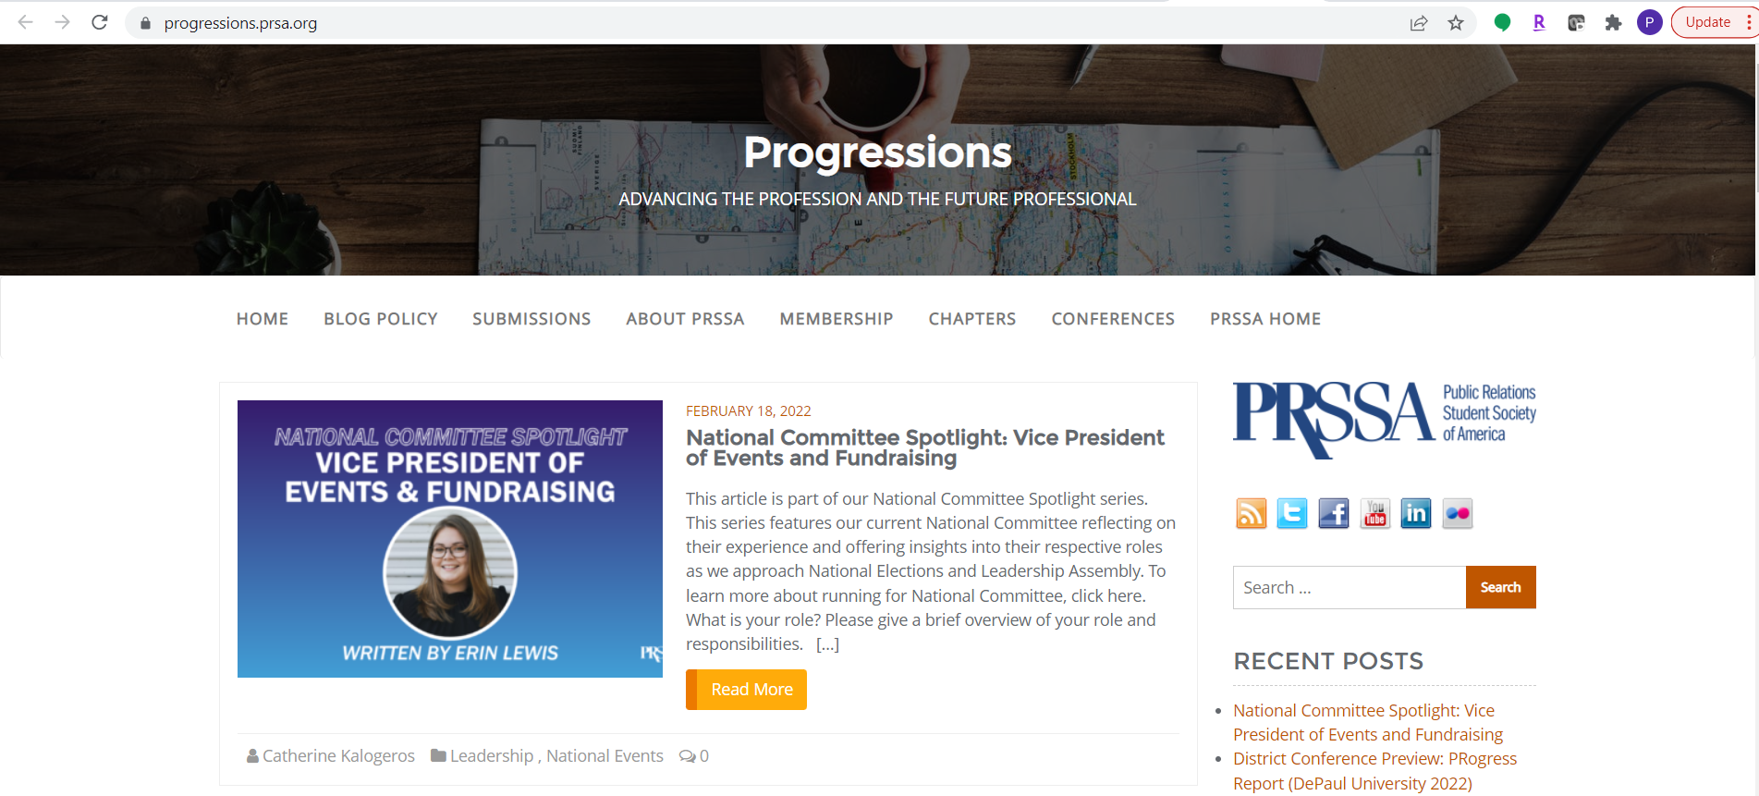
Writing

Slide 12
Internship Center
Browse career resources and job hunting tips
Search for internships by region or city
Post your résumé for employers to view
Gain access to the PRSA Job Center
Find internship opportunities for each semester

Slide 13
Discounted PRSA Membership
Transition to PRSA for the discounted rate of just $60 for an Associate Membership.
PRSA is a network of more than 18,000 professionals with:
Chapters across the country
Professional Interest Sections, including New Professionals

Slide 14
Chapter Contact Information
Chapter President:
Vice President:
Social Media:
Email:

Slide 15
Meetings & Involvement
Meetings:
[Put your meeting times and dates here. Keep it on a schedule and ask for member feedback.]
Get involved:
[Tell the members how to get involved, what committee to join, etc.]

